Slide 1

Responsible AI for the Youth
Aayan Majid
Neuqua Valley High School, Naperville

Slide 2
Outline
What is AI
Responsible AI
AI Delima for Youth
Survey Results
Solution & Conclusions

Slide 3
What is AI?
Model Training
Model Inference
Training Data
Input Data
AI deals with the creation of systems that can learn from data and predict outcomes based on their learning.
Model Training
AI Model
Output:
AI Model
Output:
Prediction
AI learning process

Slide 4
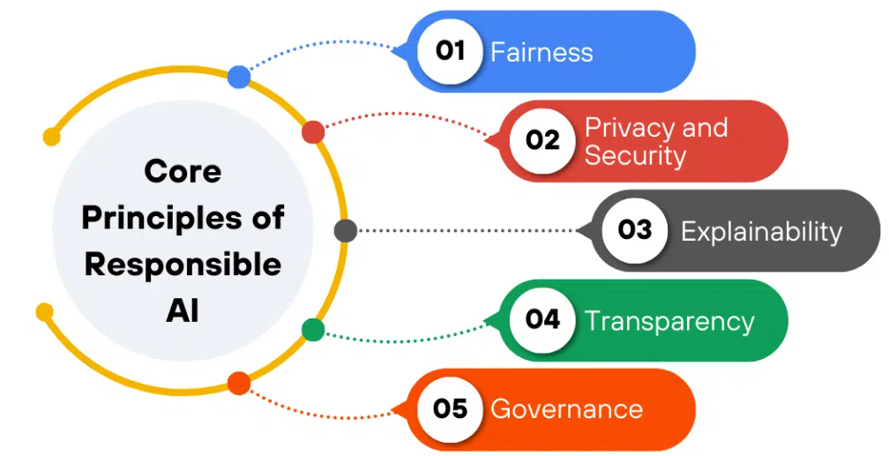
Responsible AI Framework
Responsible AI refers to the practice of developing, deploying, and using AI in a way that is ethical, transparent, fair, and accountable.
Fairness: Treatment of people of different demographics in AI.
Privacy and security are about data protection and unauthorized access in AI.
Explainability is the ability for a developer to be able to explain the algorithm of their machine and its decisions.
Transparency: How AI must communicate effectively to let user know the working of the AI system, the data it uses, and its limitations
[https://datasciencedojo.com/blog/what-is-responsible-ai-5-core-principles/]
Governance is about enforcing all the ethical AI policies through establishing clear policies, procedures, and accountability mechanisms.

Slide 5

Youth AI Delima
Unethical Behavior:
Young people may not use AI responsibly and may indulge in unethical behavior.
Privacy:
Their data may be accessed without their consent and their privacy might be compromised.
Over Reliance on AI:
They may become too dependent on AI and lose critical skills.
[https://x.com/GlobeEyeNews/status/1949212183080079607]

Slide 6
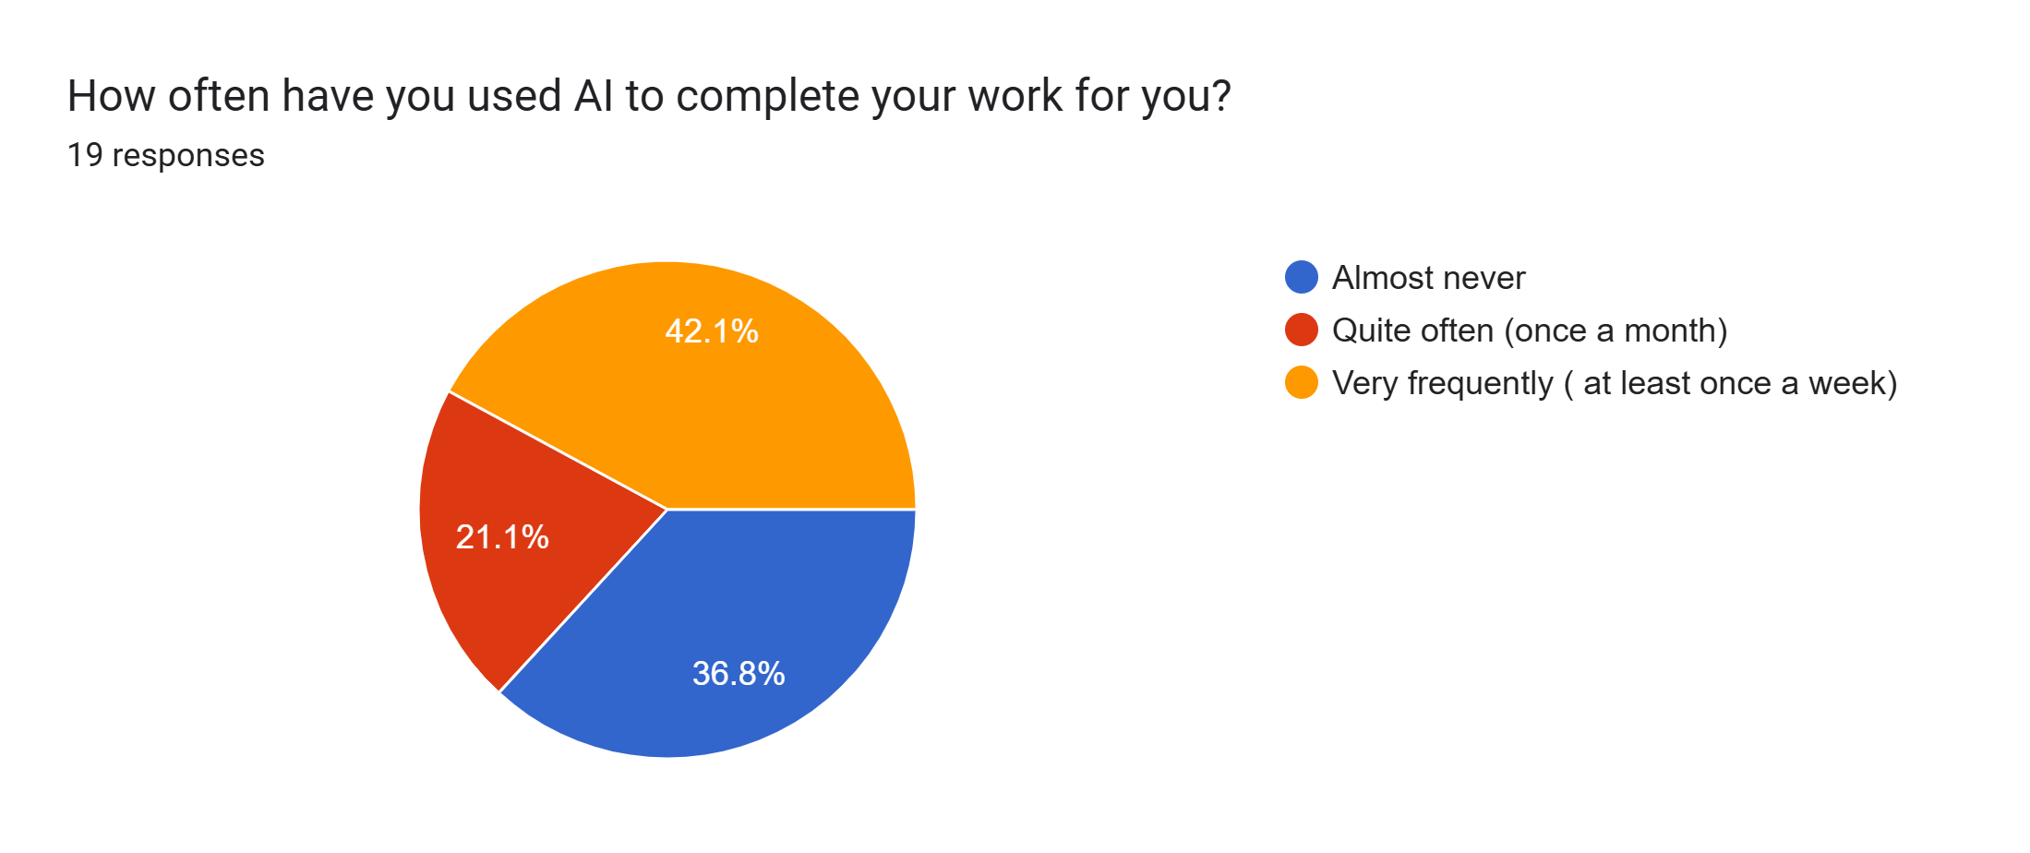
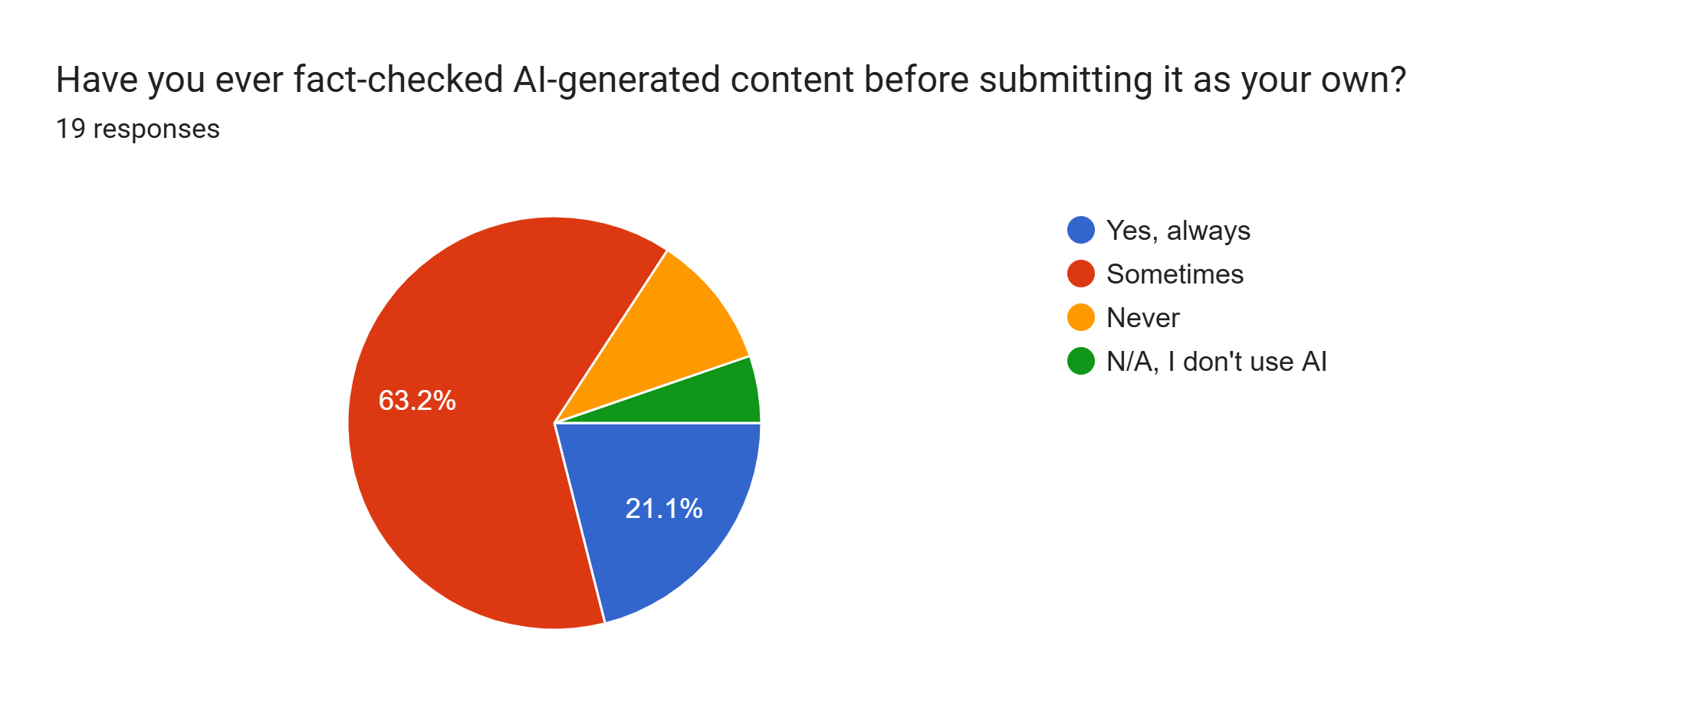
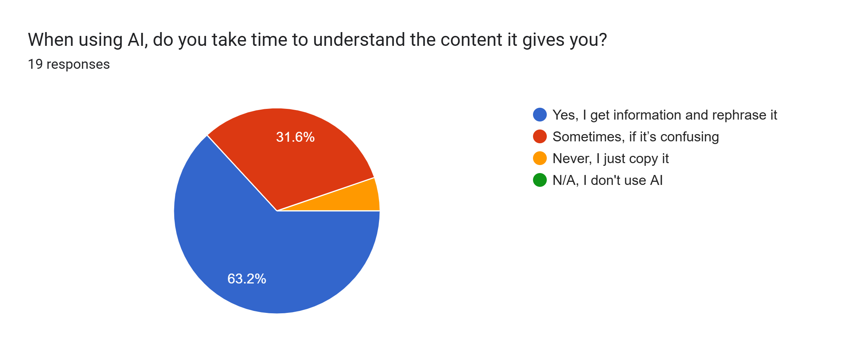
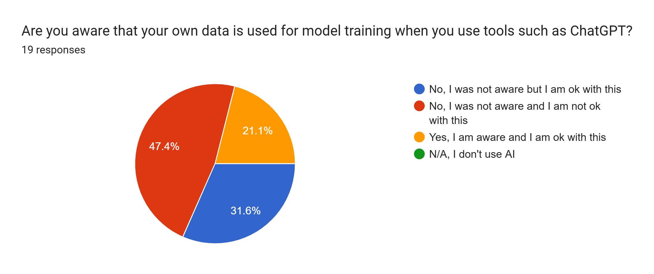
Survey Results
Key Findings:
Most students use AI very frequently
Only a minority of students fact-check their work every time
The majority of students take time to understand the content
Nearly 80% of students were unaware that their data was being exploited.

Slide 7
Solution
The schools and educators must agree on a framework for responsible AI in education.
I want to create a website with guidelines on the responsible use of AI for students based on an ethical AI code of conduct.
Create mechanisms like minigames to keep users captivated
Create quizzes that educate students about the responsible use of AI in a light, playful tone

Slide 8
Conclusions
AI is a reality, don’t block it, rather embrace it.
The majority of students (and teachers) are unaware of a responsible AI framework.
Schools should enforce policies that help both students and teachers use AI more responsibly.
Responsible AI should be part of the curriculum.

Slide 9
References
https://datasciencedojo.com/blog/what-is-responsible-ai-5-core-principles/
https://x.com/GlobeEyeNews/status/1949212183080079607

Slide 10

THANK YOU
Contact:
e-mail: aayan.majidb@gmail.com

